Slide 1
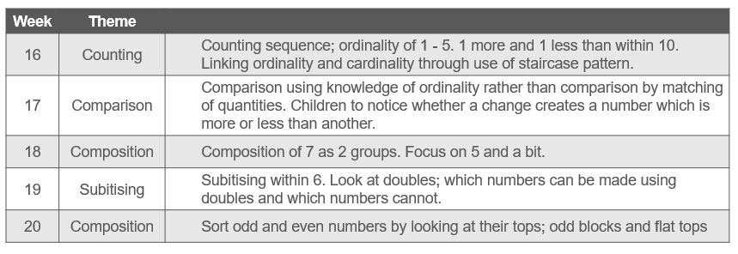
FS2
NCETM

Slide 2
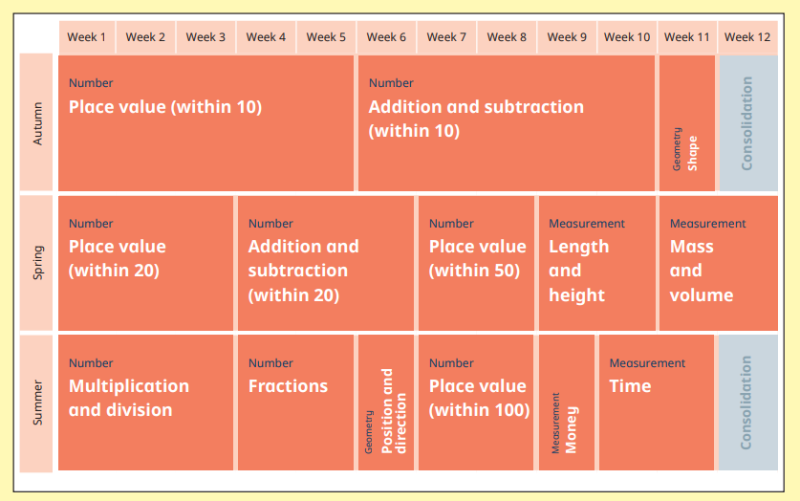
Year 1

Slide 3
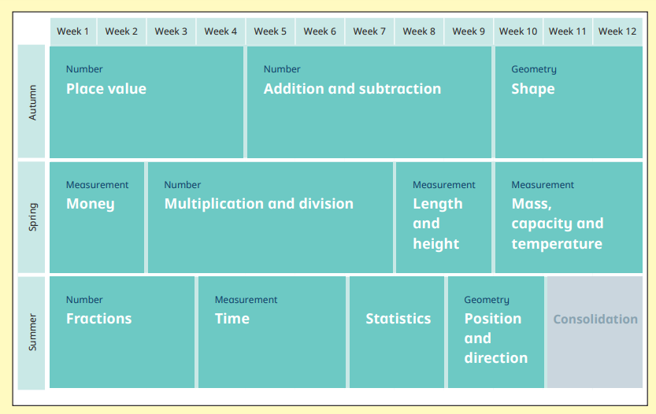
Year 2

Slide 4
Year 3

Slide 5
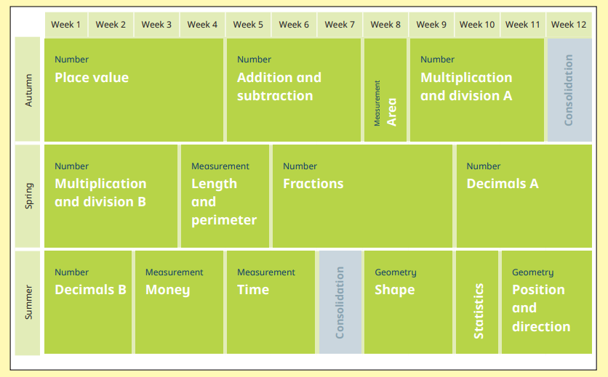
Year 4

Slide 6
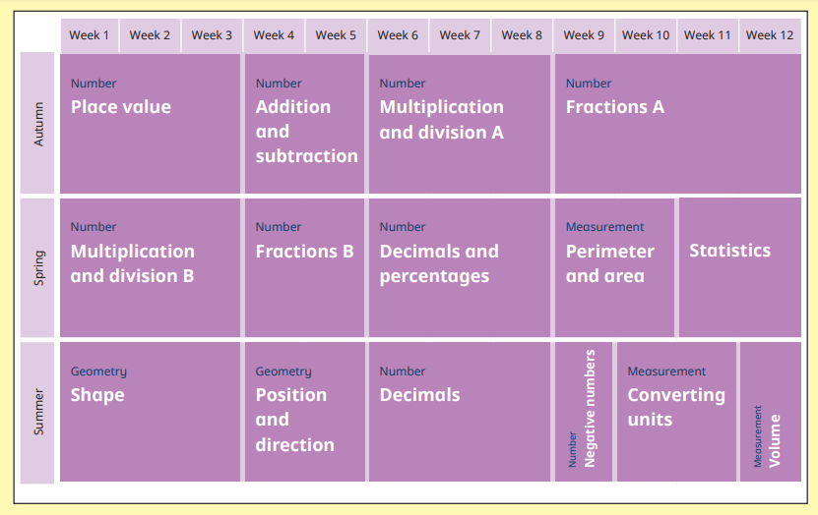
Year 5

Slide 7
Year 6

